Slide 1
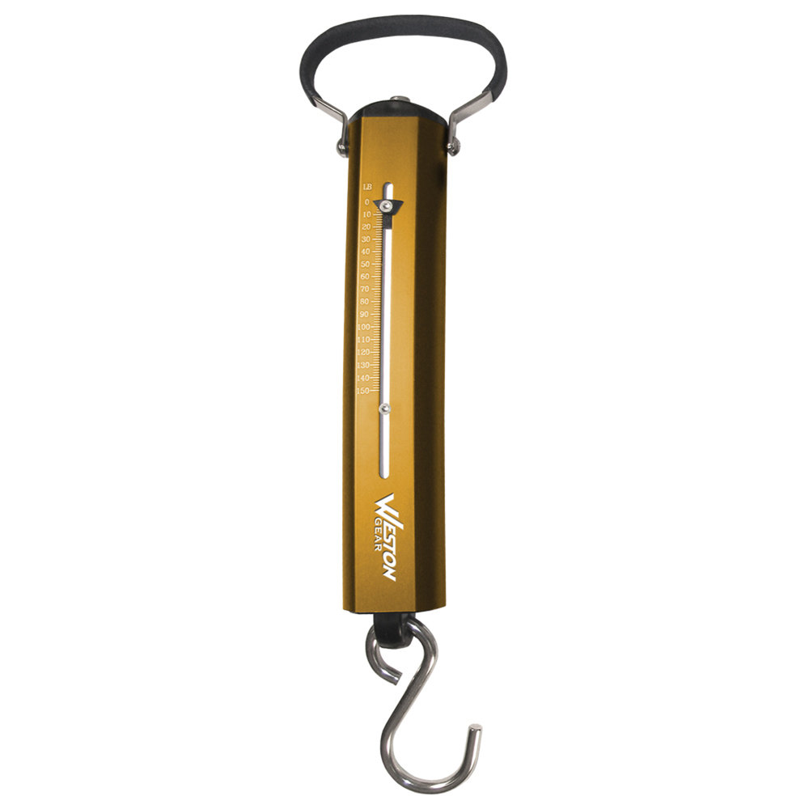
6 kg
6 kg
string tension
spring balance is in equilibrium

Slide 4
Diagram 1: Systems are rest
Pulley only changes the direction of the string tension
Y
System Block B
X
string tension
gravitational force (weight)
System B: in equilibrium
Newton’s Second Law
Y
System Sphere S
X
System S: in equilibrium
For the System to remain stationary, the mass of the block must equal the mass the mass of the sphere.

Slide 5
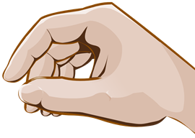
Diagram 1
Diagram 2

Slide 6
200 m.s⁻¹
N
30º
30º
200 m.s⁻¹
Y
30º
30º
X

Slide 7
Y
X
+X
initial momentum
final momentum
momentum conservation
Lost in KE

Slide 8
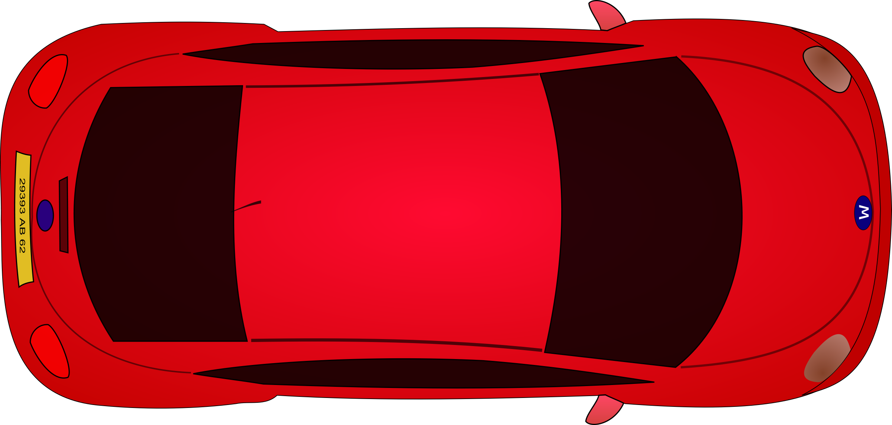


10º
10º
car
tree
Y
X
$$\vec{F}=500 \hat{j} \text{N}$$

Slide 9
Y
10º
10º
X
10º
10º
Equilibrium

Slide 10
Y
Rope pulls on car T
10º
X
Force of rope pulling cat towards tree T_{x}

Slide 12
(A)
(B)

Slide 13
Y
direction of motion of bus
acceleration of bus
X
deflection of ball
Newton’s 2nd Law
Resultant force acting on ball
String tension
11.5º

Slide 14
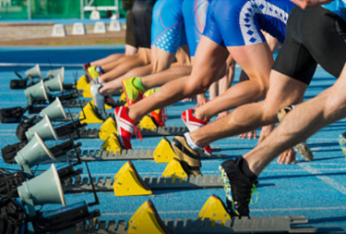
System is a sprinter
Newton’s 2nd Law
Sprinter pushes on ground F_{GS}
Ground pushes on sprinter F_{SG}
Newton’s 3rd Law F_{SG} = - F_{GS}

Slide 15


F₁ is the force of hand on ball
F₂ is the force of ball on hand
F₃ is the force of the ball on the Earth
F₄ is the force of the Earth on the ball

Slide 16
Systems
Y
Ball
m a > 0
Hand
Earth
X
F₁
F₃
F₄
F₂
F₁ is the force of hand on ball
F₂ is the force of ball on hand
F₃ is the force of the ball on the Earth
F₄ is the force of the Earth on the ball
Newton’s 3rd Law: action / reaction forces
Ball / Earth F₄ = F₃
Ball / Hand F₁ = F₂
The ball accelerates upward F₁ > F₄

Slide 17
crash barrier
v
v / 3
Kinetic Energy is a scalar quantity`
Momentum is a vector quantity
Event #1 Just before collision
Event #2 Just before collision
% Loss in kinetic energy during collision
Momentum is a vector quantity, whereas kinetic energy is a scalar. You can not subtract one vector from another without considering the directions of both vectors.

Slide 18
crash barrier
45º
45º
30º
30º
Y
Impulse = change in momentum
momentum
X

Slide 19
Event #1 Just before collision
Event #2 after collision
Impulse and change in momentum
3.14x10³
6.55x10³

